Slide 1
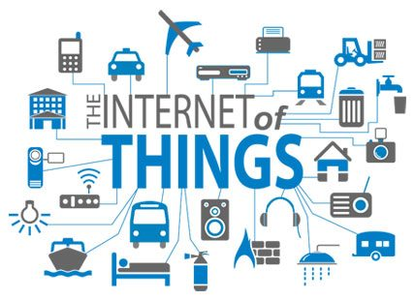
Internet of Things (IoT)

Slide 2
Plan of Presentation
What is Internet of Things?
How IoT Works?
Current Status & Future Prospect of IoT
Knowledge Management – From Data to Wisdom
The Future of IoT
The Potential of IoT
Few Applications of IoT
Technological Challenges of IoT
Criticisms & Controversies of IoT
References

Slide 3
What is IoT?
The Internet of Things (IoT) is the network of physical objects or "things" embedded with electronics, software, sensors, and network connectivity, which enables these objects to collect and exchange data.
IoT allows objects to be sensed and controlled remotely across existing network infrastructure, creating opportunities for more direct integration between the physical world and computer-based systems, and resulting in improved efficiency, accuracy and economic benefit.

Slide 4
"Things," in the IoT sense, can refer to a wide variety of devices such as heart monitoring implants, biochip transponders on farm animals, electric clams in coastal waters, automobiles with built-in sensors, DNA analysis devices for environmental/food/pathogen monitoring or field operation devices that assist fire-fighters in search and rescue operations.
These devices collect useful data with the help of various existing technologies and then autonomously flow the data between other devices.

Slide 5
History of IoT
The concept of the Internet of Things first became popular in 1999, through the Auto-ID Center at MIT and related market-analysis publications. R
Radio-frequency identification (RFID) was seen as a prerequisite for the IoT at that point. If all objects and people in daily life were equipped with identifiers, computers could manage and inventory them. Besides using RFID, the tagging of things may be achieved through such technologies as near field communication, barcodes, QR codes, bluetooth, and digital watermarking.

Slide 6
How IoT Works?
Internet of Things is not the result of a single novel technology; instead, several complementary technical developments provide capabilities that taken together help to bridge the gap between the virtual and physical world. These capabilities include:
Communication and cooperation
Addressability
Identification
Sensing
Actuation
Embedded information processing
Localization
User interfaces

Slide 7
How IoT Works?
RFID
Sensor
Smart Tech
Nano Tech
To identify and track the data of things
To collect and process the data to detect the changes in the physical status of things
To enhance the power of the network by devolving processing capabilities to different part of the network.
To make the smaller and smaller things have the ability to connect and interact.

Slide 8
The Structure of IoT
The IoT can be viewed as a gigantic network consisting of networks of devices and computers connected through a series of intermediate technologies where numerous technologies like RFIDs, wireless connections may act as enablers of this connectivity.
Tagging Things : Real-time item traceability and addressability by RFIDs.
Feeling Things : Sensors act as primary devices to collect data from the environment.
Shrinking Things : Miniaturization and Nanotechnology has provoked the ability of smaller things to interact and connect within the “things” or “smart devices.”
Thinking Things : Embedded intelligence in devices through sensors has formed the network connection to the Internet. It can make the “things” realizing the intelligent control.

Slide 9
Current Status & Future Prospect of IoT
“Change is the only thing permanent in this world”

Slide 10
IoT as a Network of Networks:
These networks connected with added security, analytics, and management capabilities. This will allow IoT to become even more powerful in what it can help people achieve.

Slide 11
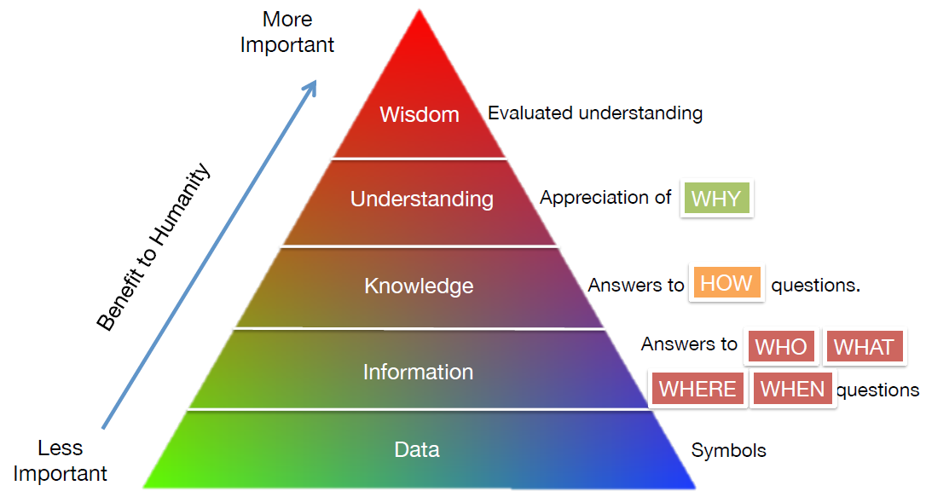
Knowledge Management – Turning Data into Wisdom
The more data that is created, the better understanding and wisdom people can obtain.

Slide 12
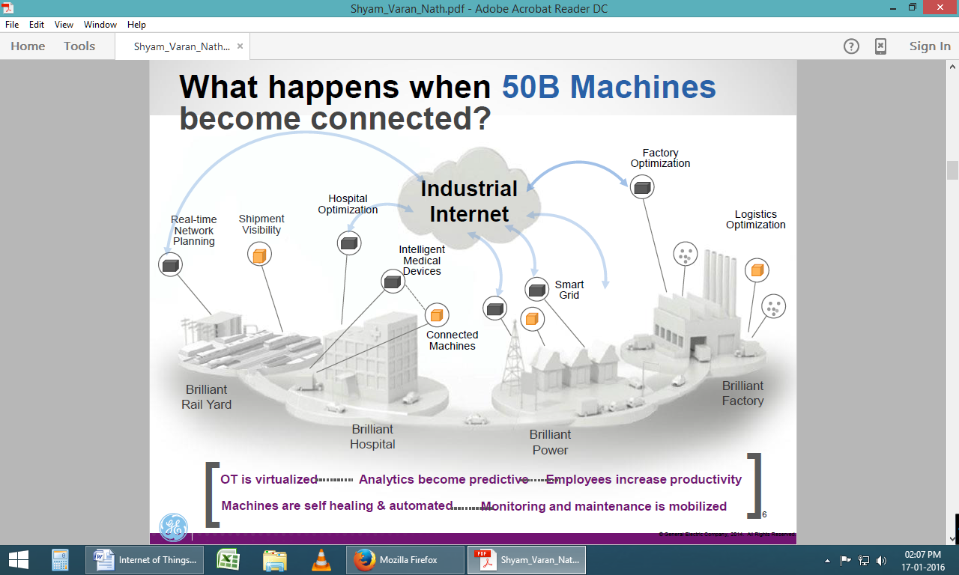
The Future of IoT
"The Sky's not the limit. It's only the beginning with IoT."

Slide 13
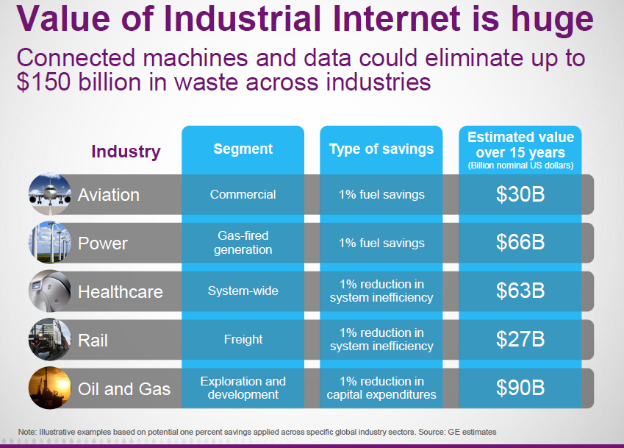
The Potential of IoT
GE’s estimates on potential of just ONE percent savings applied using IoT across global industry sectors.

Slide 14
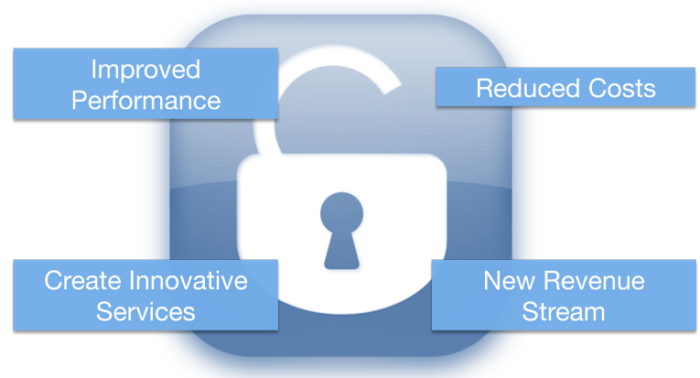
Unlock the Massive potential of IoT

Slide 15
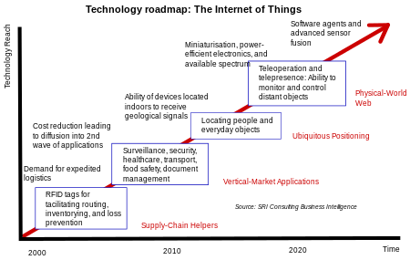
Technology roadmap of IoT

Slide 16
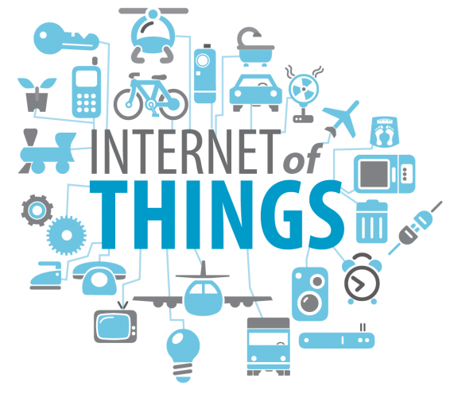
Applications of IoT
"The Ultimate Goal of IOT is to Automate Human Life."

Slide 17
Few Applications of IoT
Building and Home automation
Manufacturing
Medical and Healthcare systems
Media
Environmental monitoring
Infrastructure management
Energy management
Transportation
Better quality of life for elderly
... ... ...
You name it, and you will have it in IoT!

Slide 18
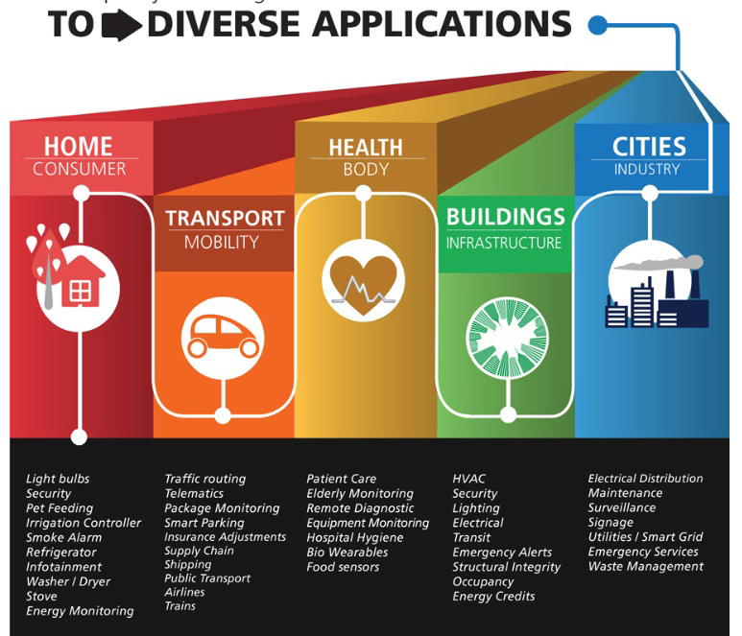

Slide 19
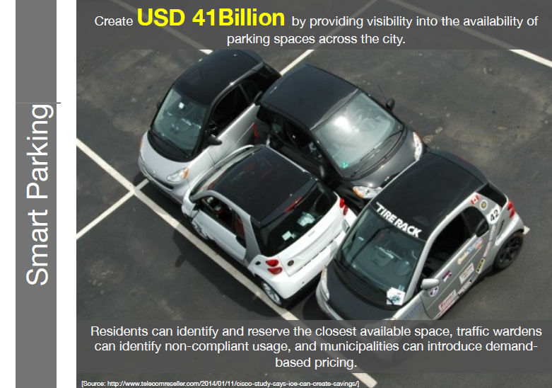

Slide 20
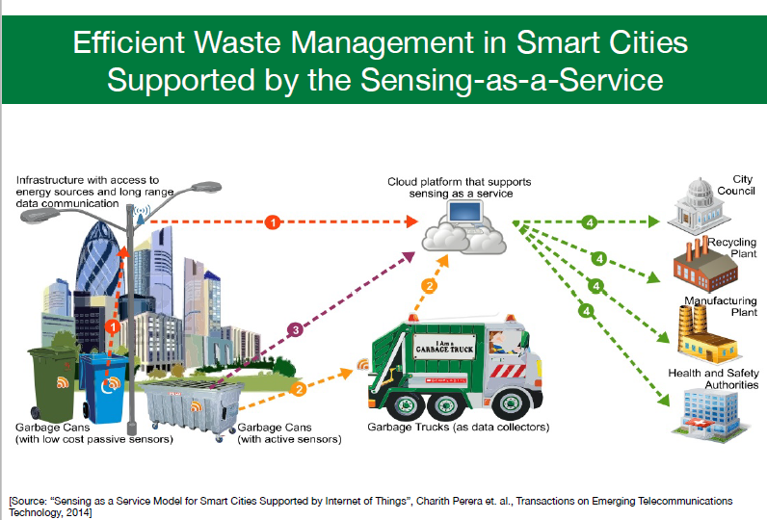

Slide 21
Sensors in even the holy cow!
In the world of IoT, even the cows will be connected and monitored. Sensors are implanted in the ears of cattle. This allows farmers to monitor cows’ health and track their movements, ensuring a healthier, more plentiful supply of milk and meat for people to consume. On average, each cow generates about 200 MB of information per year.

Slide 22
Of course, we know nothing remains static, especially when it comes to the Internet. Initiatives and advances, such as Cisco‘s Planetary Skin, GE’s Industrial Internet, HP‘s central nervous system for the earth (CeNSE), and smart dust, have the potential to add millions—even billions—of sensors to the Internet.
As cows, water pipes, people, and even shoes, trees, and animals become connected to IoT, the world has the potential to become a better place.
“With a trillion sensors embedded in the environment—all connected by computing systems, software, and services—it will be possible to hear the heartbeat of the Earth, impacting human interaction with the globe as profoundly as the Internet has revolutionized communication.” - Peter Hartwell, Senior Researcher, HP Labs.
“How much more IoT can do is only left to your imagination”

Slide 23
Internet of Things is the next stage of the information revolution and referenced the inter-connectivity of everything from urban transport to medical devices to household appliances.
Integration with the Internet implies that devices will use an IP address as a unique identifier. However, due to the limited address space of IPv4 (which allows for 4.3 billion unique addresses), objects in the IoT will have to use IPv6 to accommodate the extremely large address space required.
Objects in the IoT will not only be devices with sensory capabilities, but also provide actuation capabilities (e.g., bulbs or locks controlled over the Internet).

Slide 24
On the other hand, IoT systems could also be responsible for performing actions, not just sensing things. Intelligent shopping systems, for example, could monitor specific users' purchasing habits in a store by tracking their specific mobile phones. These users could then be provided with special offers on their favourite products, or even location of items that they need, which their fridge has automatically conveyed to the phone.
Additional examples of sensing and actuating are reflected in applications that deal with heat, electricity and energy management, as well as cruise-assisting transportation systems. Other applications that the Internet of Things can provide is enabling extended home security features and home automation.

Slide 25
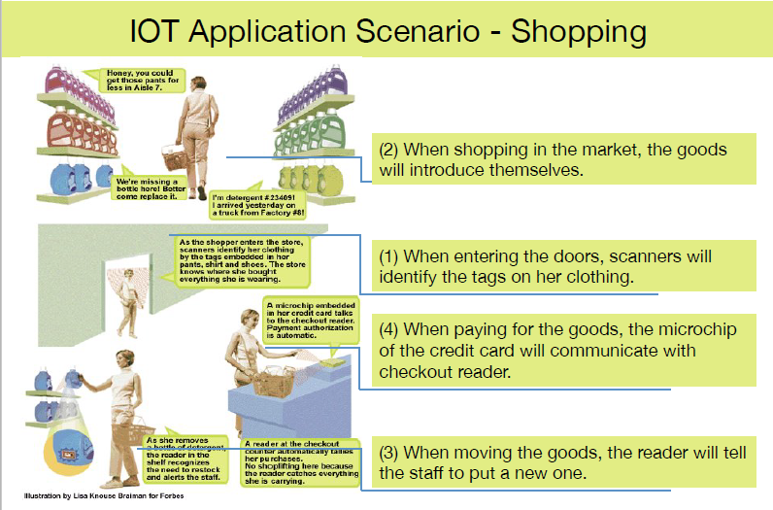

Slide 26
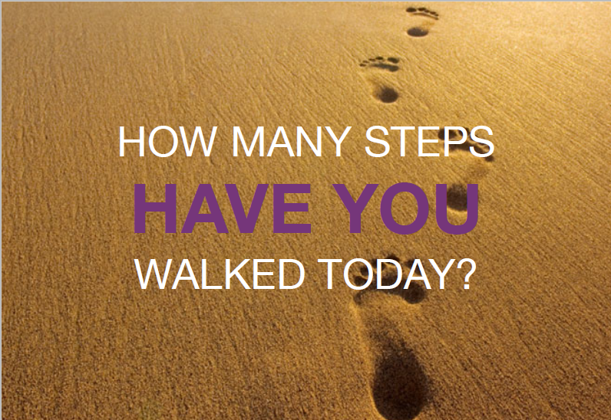

Slide 27
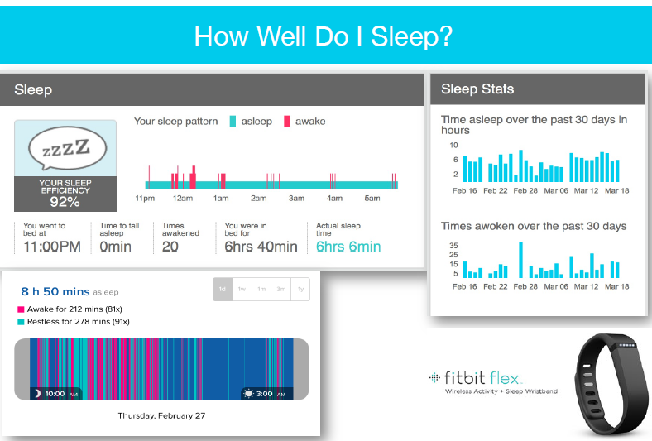

Slide 28
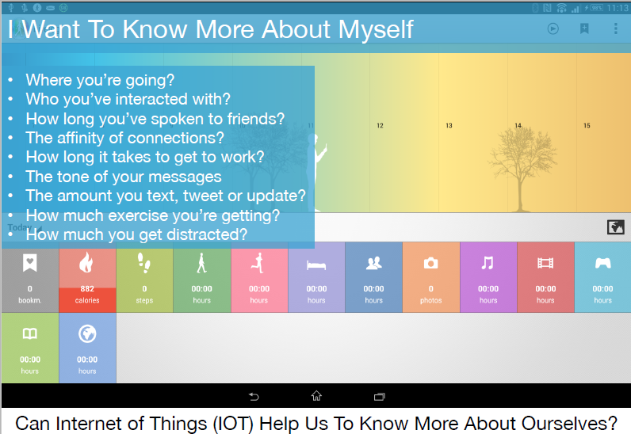
IoT helps you in LIFE LOGGING

Slide 29
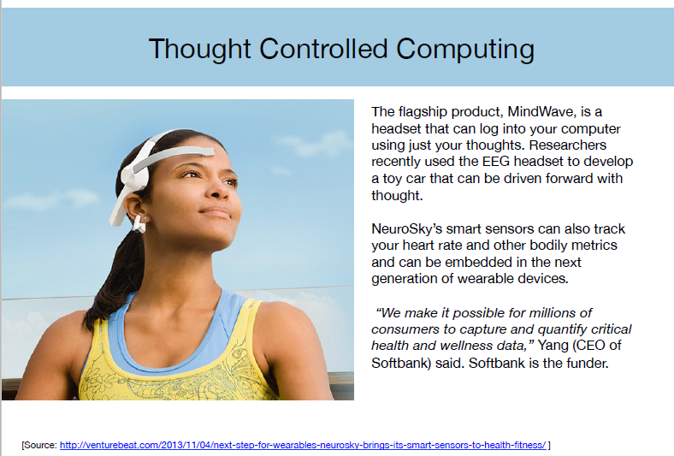

Slide 30
TECHNOLOGICAL CHALLENGES OF IoT
At present IoT is faced with many challenges, such as:
Scalability
Technological Standardization
Inter operability
Software complexity
Data volumes and interpretation
Power Supply
Interaction and short range communication
Wireless communication
Fault tolerance

Slide 31
Criticisms and Controversies of IoT
Scholars and social observers and pessimists have doubts about the promises of the ubiquitous computing revolution, in the areas as:
Privacy
Security
Autonomy and Control
Social control
Political manipulation
Design
Environmental impact
Influences human moral decision making

Slide 32
